Slide 1
Reason and emotion
(Chapter 2)
Bobir Muratov

Slide 2
Introduction
The protagonist in Crime and Punishment by Fyodor Dostoevsky, Raskolnikov, after the following conversation, decides to kill an old woman so that he could redistribute her money with those who would better benefit from it:
https://www.youtube.com/watch?v=LlIEVG6GV4A
Decision based on rational calculation – the greatest good to the greatest number of people
No emotion
Is it a good decision from the point of view of a critical thinker?

Slide 3
What’s to Come
What is Reason?
The Role of Emotion in Critical Thinking
AI, Reason, and Emotion
Faith and Reason
Critical Thinking Issue

Slide 4
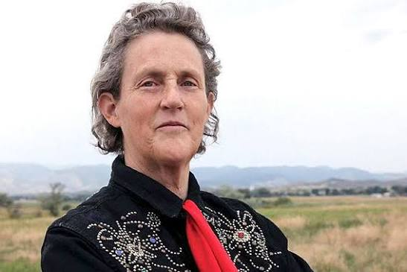
What is Reason?
Reason – the process of supporting a claim or conclusion on the basis of evidence
In addition to abstract thinking and logical argumentation, reason has a behavioral component
Reason embraces different strategies – deduction, generalization, imagination
Reason in also important in spatial-temporal problem solving
Temple Grandin, Structural Designer, person with autism

Slide 5
What is Reason?
Traditional views:
Plato – human soul has one rational and two nonrational parts – emotions and physical cravings
Religion (Christianity) – God is the perfectly rational being, rationality is the divine spark in humans
Darvin – reason evolved as part of the adaption of our and other animals behavior in the struggle for survival
20th century: reason = science

Slide 6
What is Reason?
Gender, Race, Age, and Reason:
Traditionally men = mind and reason, women = emotion
Feminists argue that men and women have the same rational nature
If women are more emotional, it does not mean that they are as capable as men in reasoning
Lifelong learning is important in reasoning skills
Critical thinkers examine their assumptions about race, gender, and age

Slide 7
What is Reason?
Dreams and problem solving:
Reasoning can be unconscious and automatic
Dreams may help solve elusive visual problems
Only occurs after a person has already done extensive work when awake
Did you find the answer in your dream?
Before going to sleep, pose a problem, think about it, write it down, and record your dreams in the morning

Slide 8
The Role of Emotion in Critical Thinking
Should critical thinking consider emotions?

Slide 9
The Role of Emotion in Critical Thinking
Cultural attitudes towards emotion:
Emotion has been set in opposition to reason in Western culture
But other cultures emphasize certain emotional traits
Emotion can enhance critical thinking by motivating us to make better decisions

Slide 10
The Role of Emotion in Critical Thinking
Emotional intelligence and the positive effects of emotion:
Emotional intelligence – the ability to perceive accurately, appraise and express emotion
Many have difficulty identifying and expressing feelings – can negatively affect behavior and decisions
Empathy (sympathy) – the capacity to enter into and understand the emotions of others
Empathetic person is more flexible and open to other perspectives

Slide 11
The Role of Emotion in Critical Thinking
Negative effects of emotion
Integrating reason and emotion

Slide 12
AI, Reason, and Emotion
https://www.youtube.com/watch?v=ARJ8cAGm6JE
Is the creation of AI, such as HAL, which is capable of reason, even possible?
If so, what are the implications of this for us?

Slide 13
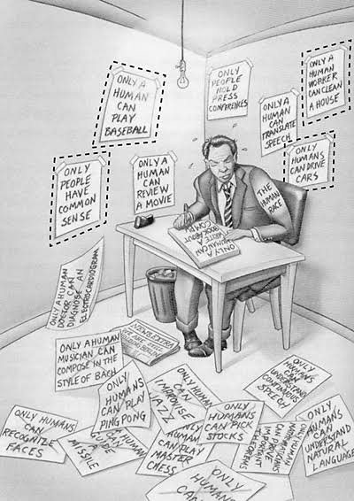
AI, Reason, and Emotion
Think about the things that only humans can do now?
Will AI be able to do some or all of these tasks in the future?
How does the thought that AI may be able to do more human tasks make you feel?

Slide 14
AI, Reason, and Emotion
Can computers think?
Turing test
Can computers feel emotions?
Think about the ways AI is being used
to enhance our critical thinking abilities and decision making,
and also negatively affect on our critical thinking skills?

Slide 15
Faith and Reason
Can faith be achieved through reason?
Is faith without reason desirable?

Slide 16
Faith and Reason
Faith ≠ reason
Faith – belief, trust, and obedience to a religious deity
Fideism – the belief that the divine is revealed through faith and does not require reason
Weaknesses?

Slide 17
Faith and Reason
Rationalism – the belief that religion should be consistent with reason and evidence
Atheist – a person who does not believe in the existence of a personal God
Agnostic – a person who believes that the existence of God is ultimately unknowable
Critical rationalism – the belief that faith is based on direct revelation of God and that there should be no logical inconsistencies between revelation and reason
Does faith have a role in critical thinking?

Slide 18
Critical Thinking Issue
https://archive.nytimes.com/www.nytimes.com/books/first/k/kurzweil-machines.html
https://www.zygonjournal.org/article/13063/galley/26503/view/
Read the following contrasting views on AI capabilities, being human, and faith
Think about the differences in views and the strength of arguments
Relate them to your understanding of God and faith. If you believe in God, is faith in God incompatible with a belief that AI may someday equal or surpass human intelligence and consciousness?

